Slide 1
Epistemic Worldviews and Research Approaches
Module 1, Introduction to Capstone, AP Seminar

Slide 2

What is Research?
2
?
Research, simply defined, is a process for investigating a
problem using an accepted method or formal system for
producing knowledge to fill a gap in understanding.

Slide 3
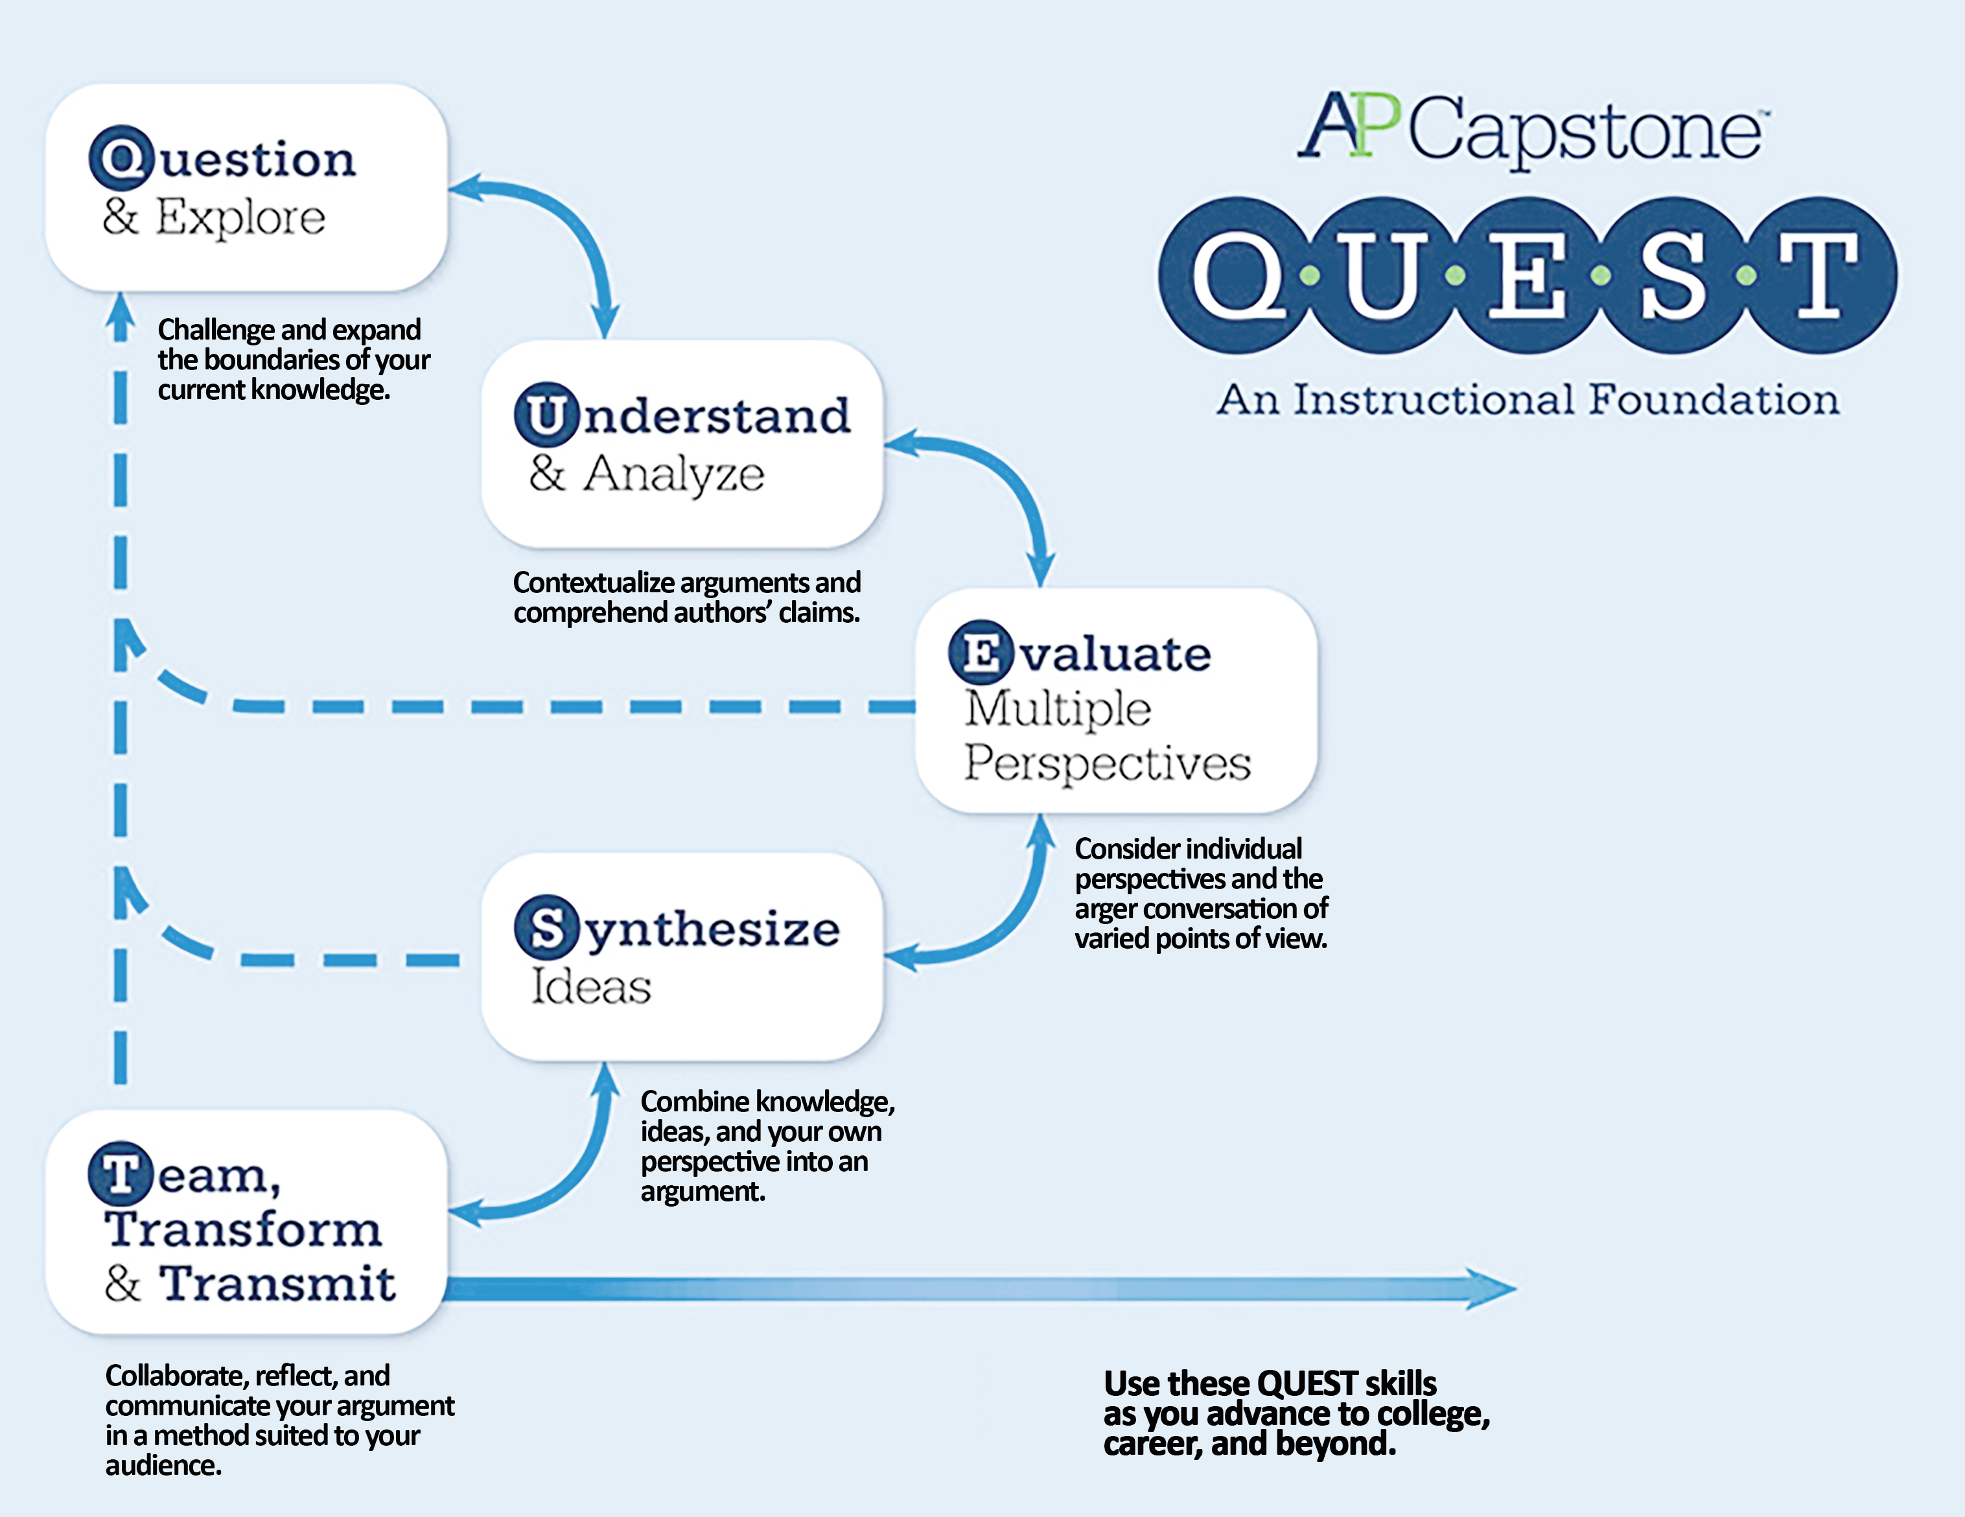
The College Board QUEST Model
3

Slide 4


Knowledge and Understanding
4
A Quick Introduction to Epistemology
Epistemology: theories, studies, philosophical investigations into ‘knowledge’
Questions: What is knowledge? How does one come to ‘know’ something?
Goal: to give a set of “necessary and sufficient conditions for claiming ‘to know’ something (aims at widely-accepted conditions)
The ‘gold standard’ of achieving knowledge: justified, true belief
The role of Research: a particular approach (resting on assumptions and acceptance of systems) to securing knowledge

Slide 5
The High Threshold
5
Defining “Justified, True Belief”
Justified = verifiable through evidential support [note: often systematically acquired]
True = “what actually is—in fact—the case” [note: requires metaphysical standpoint]
Belief = something “held to be the case” [independent of Truth, but often the intersection of Justification and Truth]

Slide 6

Education and Learning
6
An Example
Each subject taught in school follows its own schema for knowledge
Sciences: scientific methods
Mathematics: conceptual proofs and numerical relationships
Language Arts: rhetorical analysis
Social Sciences: social research methods
Understanding lies in the interaction between information-as-given, the investigator’s personal background beliefs and approaches to knowledge, and those of the audience to which they share the contextualized information
Personal perspective, approaches, and epistemic beliefs play a role in the kind of investigation and/or argumentation or evidence a student/researcher will accept [in other words, one’s Epistemic Worldview]
Example: if I believe knowledge only comes from sense experience, certain personal, spiritual, intuitive experiences may constitute lesser forms (or non-forms) of knowledge—as a result, likely to investigate areas of knowledge produced by scientific methodology

Slide 7

Select Research Approaches Consistent with Epistemic Worldviews
7
Positivism
Constructivism
Interpretivism
Hermeneutic
Post-modernism
1
2
3
4
5
*these views, and introductions to them, adapted from Michael Crotty’s Foundations of Social Research

Slide 8
Positivism as a Research Approach
8
1
Name meaning: “Something that is posited” (i.e., assumed as the basis for an investigation, not the outcome of it)
Objective in approach: assumes there is a true world to be discovered independent of human perception, but can be known through observation and experimentation
Method: scientific, systematic testing; interest in principals and ‘essential facts’; avoids personal perception, feeling, assumptions, context

Slide 9
Constructionism as a Research Approach
9
2
Name meaning: “Something that is constructed” (i.e., world has potential meaning, conscious mind endows experience with it—not inherent)
Objective, but not merely: objective world exists, and human perception interacts with it (there are things to know, but knowers must interact with it from limited contexts)
Subject-object interaction = intentionality (i.e., minds interact with world through relation, reference, direction, positionality)
Context is necessary, interpretation is the means: no true interpretation, only useful interpretations
Method: quantitative studies, aim for generalizing concepts from replicable experiences and provided subjective information (e.g., surveys)

Slide 10
Interpretivism as a Research Approach
10
3
Name meaning: foil to positivism, looks for culturally-derived and historically situated interpretations in a social world (not an objective one)
Natural reality ≠ Social reality, and thus require different means of investigation
Methods: not in causality; focus on relations, correlations, investigations into social actions, phenomena (case studies, observations of human phenomena, interviews); cultural studies

Slide 11
Hermeneutic Approach to Research
11
4
Name meaning: role of language in human behavior (sub-type of interpretivism)
Language shapes experience, experience shapes language
Methods: textual studies and analyses, text as ‘living thing’; concept and content analysis and effects of language on understanding as a “fusion of horizons” (dialectic models); research in the arts

Slide 12
Postmodernism as a Research Approach
12
5
Name meaning: contrast to ‘modernism’ (specifically Enlightenment thinking and reliance on rationalism and observable patterns in social truth, understanding)
Rejects “dominant foundational program of the Western tradition”
Methods: Relies on “play” and deconstruction of accepted ‘norms’ of knowledge; skepticism, rearrangement; emergence of critical lenses responsible for gender, racial theories, and approaches

Slide 13
AP Capstone, Research and Critical Writing as Foundational
13
An Example
Assumption of the program rests in justified, true belief
Critical approach: knowing subject matter + knowing self-as-investigator + knowing intended (and unintended) audience
Defining “Critical”
Not ‘criticism’ or ‘critical’ in sense of cynical judgment or “nit-picking”
From ancient Gr: “to judge”- beyond opinion, tested, measured, informed belief
Rests in deep-level learning, critical awareness

Slide 14


Surface-level vs. Deep Learning
14
Surface-level
Recall facts, information
Tasks as ‘tests of memory’
Concern with ‘meeting requirements’ or completion
Relies on reproduction, generalities
Deep
Need for understanding over regurgitation
Readiness and willingness to explore
Acceptance of chaos, desire to find (or construct) patterns/order
Curiosity, and dedication to time and consideration

Slide 15

Critical Research Approach
15
A Process Overview
1
Introduction
2
Investigation
3
Argumentation
4
Examination
5
Conclusion
Introduce the
problem, issue,
important
foundations
Investigate
relevant
perspectives,
presented evidence
Prosecute, defend
ideas with clear
reasoning
Cross-examine
Perspectives
(own and others’)
Reach an
Informed ‘verdict’

Slide 16
Important Keys to Good Research Mindsets
16
Bracket personal feelings
Examine a lot of different angles
Check and recheck for accuracy
Check logic, systemic understanding (key is knowing epistemic approach)
Look for potential flaws
Aiming to find consensus, common ground
Fact-checking against interpretations
Understanding process for collection, analysis of information-as-given
Reviewing, investigating undeclared assumptions, biases
Consideration of alternatives

Slide 17
Who Are You As a Researcher?
17
i
Begin by providing a self-introduction with a focus on your personal worldview - consider such things as your cultural background, values that have been instilled in you via family, environment, school, etc., what your beliefs about knowledge and understanding are, and how you explore the world. Then, discuss how those beliefs, values, etc. play into your areas of personal, academic, and future career interests.

Slide 18
Who Are You As a Researcher? (part 2)
18
Consider how your views manifest a specific approach to those personal, academic, and future career interests in addressing the following questions:
In what ways do you gather data or information in order to 'know' or 'understand' something in those areas of interest?
How do you prove (or accept proof) of a truth in these areas of interest? In other words, what is 'quality' work in these areas?
Do you believe that one 'way of knowing' is better (or more preferred or justified) than others? Justify your thoughts here.
What kinds of biases do you hold, and how will you work to ensure that they do not impact an objective approach to inquiry in your areas of interest?

Slide 19
Who Are You As a Researcher? (part 3)
19
Finally, reflect on areas of strength and how those strengths will become an asset to what you know about this program at this time. Also, reflect on areas of weakness and how the program can help you develop these weaknesses. Then, discuss areas of interest, CTE skills, pathways, etc., that may become avenues of research for you in this program.

